Slide 1
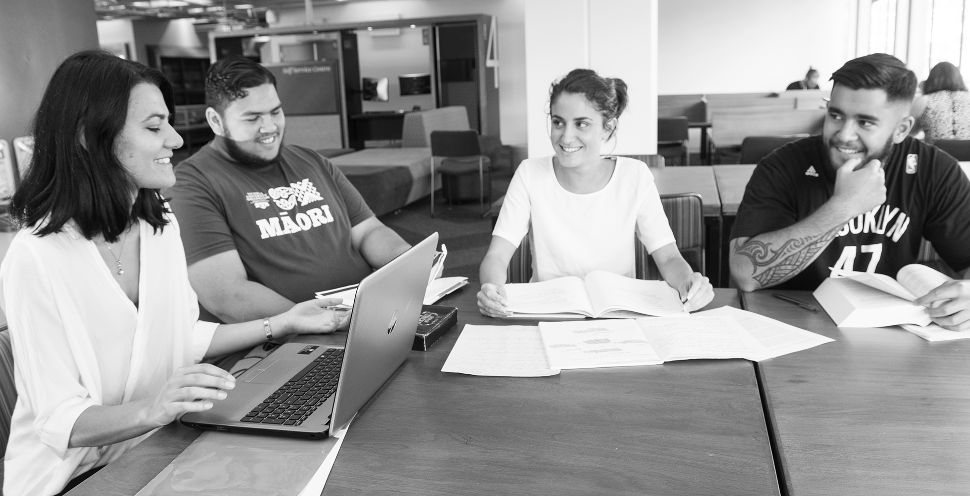
Ōritetanga Learner Success
Morgan Healey, Manager Learner Success

Slide 2
The TEC’s vision
A resilient, prosperous New Zealand – where every person has the skills, knowledge and confidence to create a fulfilling life
Notes:
Because this is the TEC Vision.
“every person has the skills, knowledge and confidence to create a fulfilling life.”
Every person…
We therefore need a tertiary education system which is fit for purpose… for everyone
And at the moment, it’s just not… arguably, probably never was…

Slide 3
To achieve this, we need to do more
Notes:
This graph show the trend in qualification completions for Māori, Pacific and Non-Māori and Non-Pacific learners at level 4 to 7 non degree. While we’ve seen a steady increase in overall qualification completions, the equity gap has gotten worse in recent years.
Part of the reforms and why we’re all here today if reflected back to us. Our former VET system was not working well for learners – and for that matter industry, communities, iwi, regions and businesses.

Slide 4
Equity depends on all parts of the system working
TEO Leadership prioritises outcomes for all learners
TEC’s internal capability and external relationships build a system that works for all
Funding, monitoring and accountability drive good outcomes
Learners
Education and careers information and opportunities support everyone to make great decision
Empowered employers and communities influence tertiary education relevance and outcomes
A capable system and providers deliver learner success
Notes:
To achieve equity, we’ve designed a work programme that focuses on shifting the entire system to be learner centric; not just TEOs.
We need to ensure that everything the TEC does is focused on delivering successful outcomes for learners – through our investment, careers and monitoring functions.
We need employers, businesses, iwi, communities and regions to can inform and influence the relevance of tertiary education.
We need capable providers who take an intentional and whole of organisation approach to learner success.
Two things I’ve learned since coming into this role:
As part of the tertiary education system, the TEC is both part of the problem but also key to the solution. We’re doing more to support and create solutions.
It is the system that is broken, not the learners within it.
“we have been so obsessed with finding ways to resuscitate the canaries....that we have failed to examine the integrity of the mineshaft itself”-

Slide 5
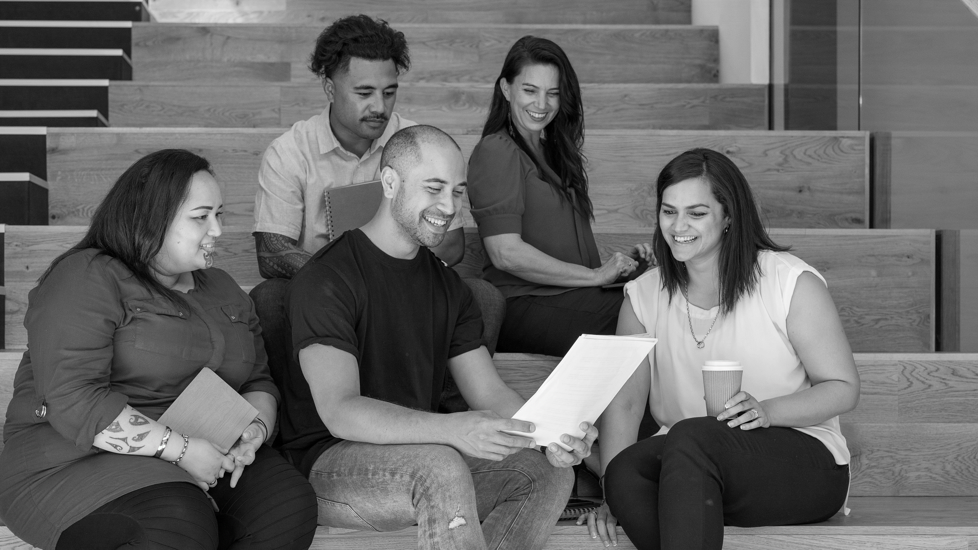
Who are our learners?
Notes:
Who are our learners?
There many different learners in our tertiary education system.
Let’s meet two learners:
Aroha is in her second year studying business communications. She’s a solo mum with a two-year old son. While Aroha is studying her son is looked after by her mother who has health issues.
John is in first year. He’s lost his job in during the last COVID lockdown in Auckland. John’s the first in his family to participate in higher-learning and he’s finding it hard to adjust to a structured learning environment.
The Government’s goal is to achieve equity for all tertiary learners in terms of participation and achievement. (A key priority for RoVE and the new entities is addressing inequity, especially for Māori, Pacific, and disabled learners.)
Many Māori, Pacific, disabled and low-income learners face barriers that affect their participation in and completion of tertiary study.
We want all learners to receive the support they need to be successful.
But most of our systems have been designed around a picture of a learner that is out of touch with current realities. Equity means to allocate resources and opportunities based on specific needs to achieve greater fairness of treatment and outcomes.
To achieve this kind of fairness we need each organisation in the tertiary sector to fully commit to putting learners at the centre of everything they do.
Full commitment means implementing a whole-of-organisation approach to learner success.

Slide 6
Learner Success Approach
Learner Success Framework
Seven Capabilities
Notes:
TEC’s is working with tertiary education organisation to implement a whole-of-organisation learner success approach.
Changing an operating model is a multi-year processes and we have tools to make this easier for providers.
The TEC has design and tested a Learner Success Framework to give TEOs a blueprint for change that will put learners at the centre of their work. It is based on evidence from international and local best practice.
Underpinning the framework are seven capabilities which drive the cultural shift which is needed.
Talk about the importance of leadership, partnerships and guide pathways

Slide 7
Now is the time
Notes:
We are in a unique to position – Te Pūkenga, Regional Skills Leadership Groups, Workforce Development Councils
Joint accountability
By working together with the sector, we can achieve more equitable outcomes for all learners and position Aotearoa New Zealand’s tertiary education system as a world leader in equitable learner success approaches.

Slide 8
Tertiary Education Commission and tertiary education organisations are working together to put the learner first and help them succeed.
Notes:
Finish with - This is our moment – let’s make the most of it!

